Slide 1
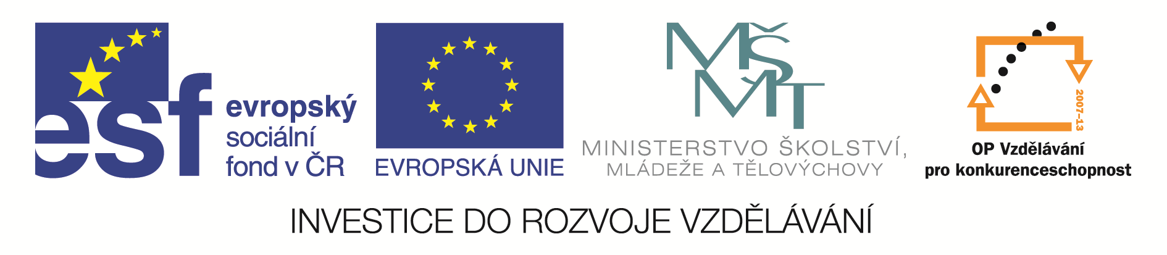
Inovace studia hydrobiologických disciplín s důrazem na rozšíření možností uplatnění absolventů biologických oborů PřF UP v praxi.
reg. číslo: CZ.1.07/2.2.00/28.0173
Přehled odborné literatury
Aktualizováno 11. 5. 2015

Slide 2
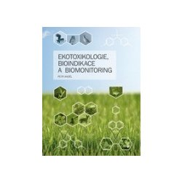
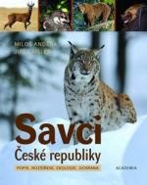
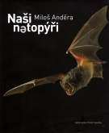
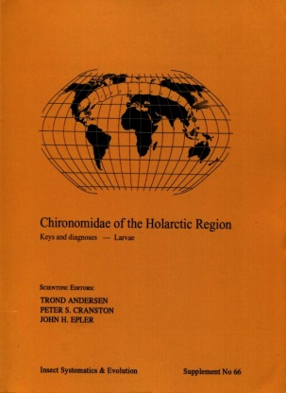
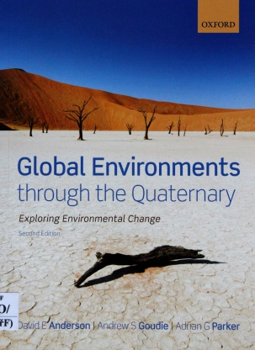
Anděl P (2011): Ekotoxikologie, bioindikace a biomonitoring. Evernia, Liberec, 243 pp.
Anděra M, Gaisler J (2012): Savci České republiky: popis, rozšíření, ekologie, ochrana. Academia, Praha, 285 pp.
Anděra M (2014): Naši netopýři. Správa jeskyní České republiky, Průhonice, 167 pp.
Andersen T, Cranston PS, Epler JH (eds.) (2013): Chironomidae of the holarctic region: Keys and diagnoses – larvae. Insect systematics and evolution, Lund, 573 pp.
Anderson DE, Goudie AS, Parker AG (2013): Global environments through the quaternary: Exploring environmental change (second edition). Oxford university press, Oxford, 406 pp.

Slide 3
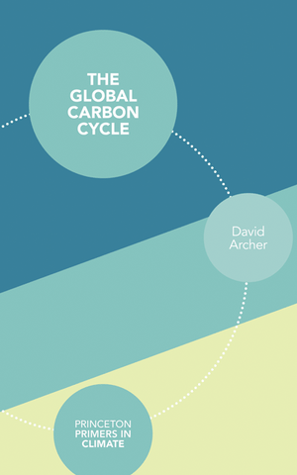
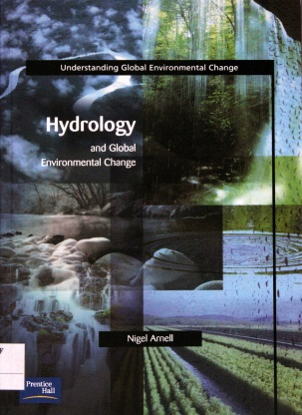
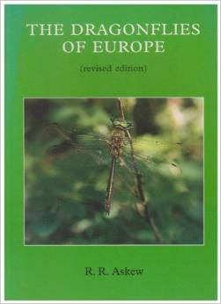
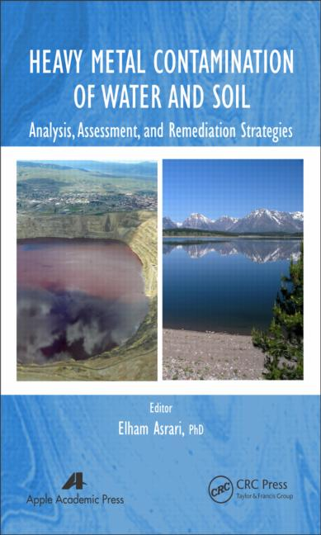
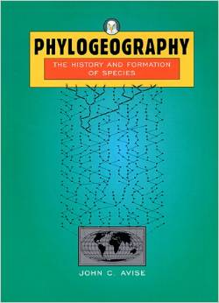
Archer D (2010): The Global Carbon Cycle. Princeton University Press, Princeton, 216 pp.
Arnell N (2002): Hydrology and global environmental change. Prentice Hall, Harlow, 346 pp.
Askew RR (2003): The dragonflies of Europe. Harley Books, Colchester, 308 pp.
Asrari E (ed.) (2014): Heavy Metal Contamination of Water and Soil: Analysis, Assessment, and Remediation Strategies. CRC Press, London, 386 pp.
.
Avise JC (2000): Phylogeography: the history and formation of species. Harvard University Press, Cambridge, 464 pp.

Slide 4
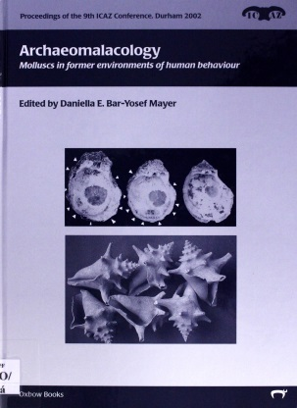
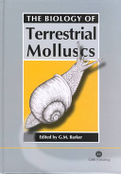
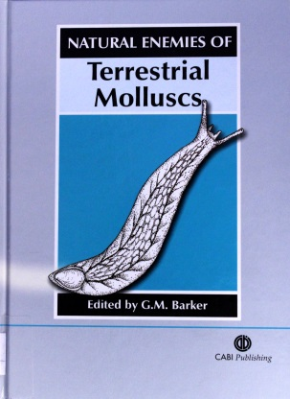
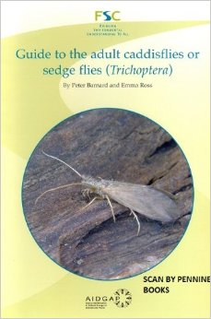
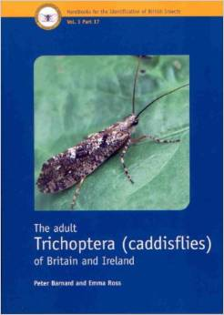
Bar-Yosef Mayer DE (ed.) (2005): Archaeomalacology: Molluscs in former environments of human behaviour. Oxbow books, Park End Place, 184 pp.
Barker GM (2001): The Biology of Terrestrial Molluscs. CABI Pub., Wallingford, 558 pp.
Barker GM (ed.) (2004): Natural enemies of terrestrial molluscs. CABI publishing, Wallingford, 644 pp.
Barnard PC, Ross E (2008): Guide to the adult caddisflies or sedge files (Trichoptera). FSC Publications, Shrewsbury, 12 pp.
Barnard PC, Ross E (2012): The adult Trichoptera (caddisflies) of Britain and Ireland. Royal Entomological Society, St. Albans, 198 pp..

Slide 5
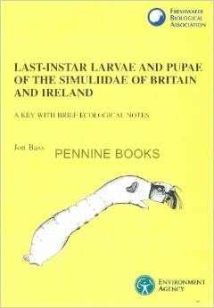
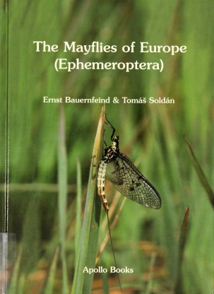
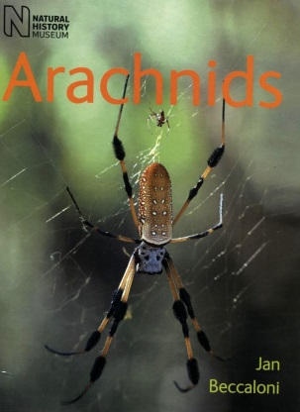
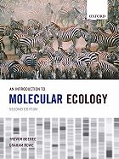
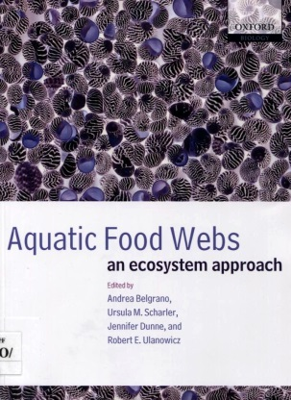
Bass J (1998): Last-instar larvae and pupae of the Simullidae of Britain and Ireland: a key with brief ecological notes. Freshwater Biological Association, Ambleside, 104 pp.
Bauernfeind E, Soldán T (2012): The mayflies of Europe (Ephemeroptera). Apollo books, Ollerup, 781 pp.
Beccaloni J (2009): Arachnids. Natural history museum, London, 320 pp.
Beebee T, Rowe G (2007): An introduction to molecular ecology. Oxford University Press, Oxford, 416 pp.
Belgrano A, Scharler UM, Dunne J, Ulanowicz RE (eds.) (2005): Aquatic food webs: an ecosystem approach. Oxford University Press, New York, 262 pp.

Slide 6
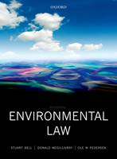

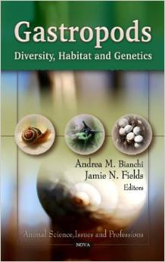
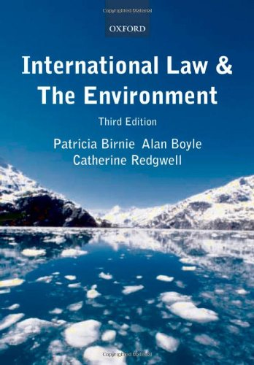
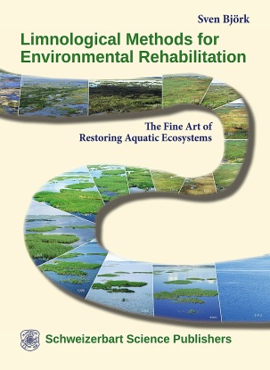
Bell S, McGillivray D, Pedersen O (2013): Environmental law. OUP Oxford, Oxford, 848 pp.
Bhatt S (2009): International Environmental Law. APH Publishing Corporation, Delhi, 287 pp.
Bianchi AM, Fields JN (eds.) (2011): Gastropods: Diversity, Habitat and Genetics. Nova Science Pub Inc, New York, 206 pp.
Birnie P, Boyle A, Redgwell C (2009): International Law and the Environment. Oxford University Press, Oxford, 888 pp.
Björk S (2014): Limnological Methods for Environmental Rehabilitation. Schweizerbart Sche Vlgsb., 381 pp.

Slide 7
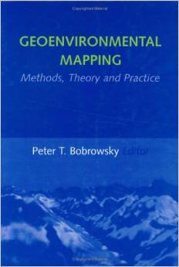
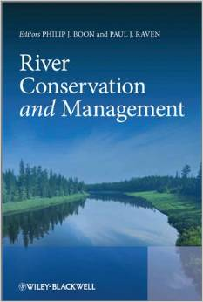
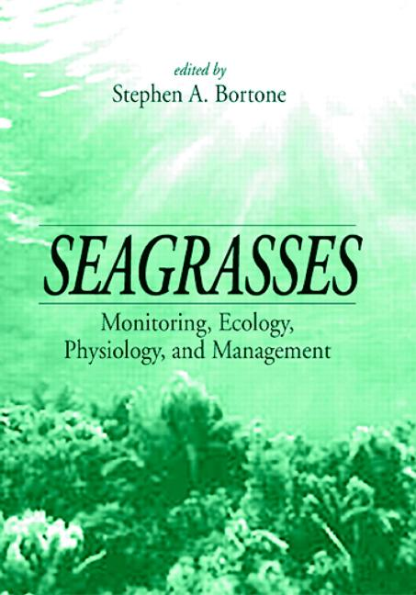
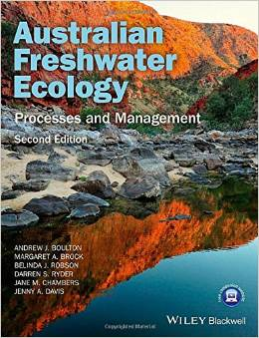
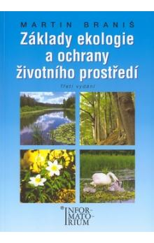
Bobrowsky PT (2001): Geoenvironmental Mapping: Methods,Theory and Practice. CRC Press, London, 750 pp.
Boon P, Raven P (eds.) (2012): River conservation and management. Wiley-Blackwell, Chichester, 432 pp.
Bortone SA (1999): Seagrasses: Monitoring, Ecology, Physiology, and Management. CRC Press, London, 336 pp.
Boulton A (2014): Australian freshwater ecology : processes and management. Wiley-Blackwell, Chichester, 386 pp.
Braniš M (2003): Základy ekologie a ochrany životního prostředí: učebnice pro střední školy. Informatorium, Praha, 203 pp.

Slide 8
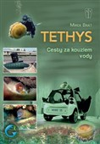
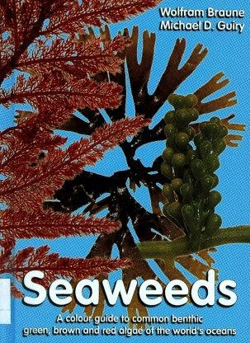
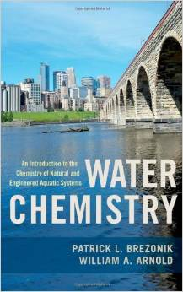
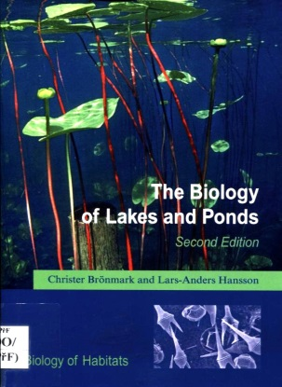
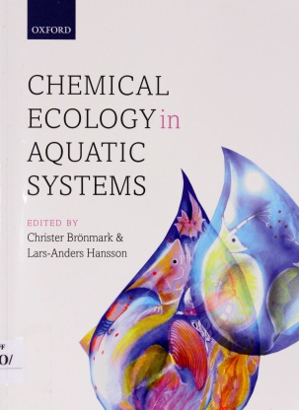
Brát M (2012): Tethys: cesty za kouzlem vody. Naše vojsko, Praha, 275 pp.
Braune W, Guiry MD (2011): Seaweeds: A colour guide to common benthic green, brown and red algae of the world's oceans. Koeltz scientific books, Koenigstein, 601 pp.
Brezonik P, Arnold W (2011): Water Chemistry: An Introduction to the Chemistry of Natural and Engineered Aquatic Systems. Oxford University Press, Oxford, 808 pp.
Brönmark Ch, Hansson LA (2005): The biology of lakes and ponds. Oxford University Press, New York, 285 pp.
Brönmark Ch, Hansson LA (eds.) (2012): Chemical ecology in aquatic systems. Oxford university press, New York, 291 pp.

Slide 9
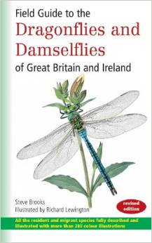
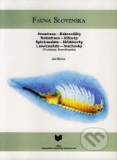
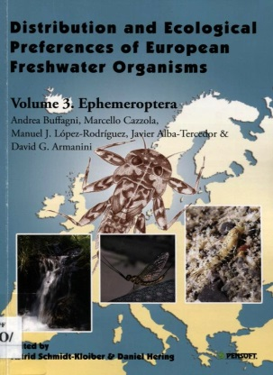
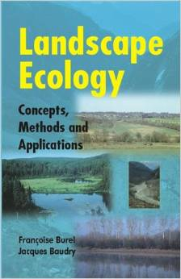
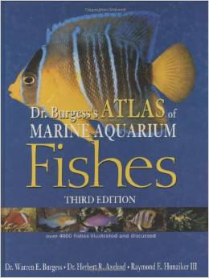
Brooks S, Lewington E (1997): Field guide to the dragonflies & damselflies of Great Britain and Ireland. British Wildlife Publishing, Oxford, 160 pp.
Brtek J (2005): Fauna Slovenska II. Veda, Bratislava, 144 pp.
Buffagni A, Cazzola M, López-Rodríguez MJ, Alba-Trecedor J, Armanini DG (2009): Distribution and ecological preferences of european freshwater organisms: Volume 3 Ephemeroptera. Pensoft, Sofia, 254 pp.
Burel F, Baudry J (2003): Landscape Ecology: Concepts, Methods and Applications, CRC Press, London, 378 pp.
Burgess WE (2000): Dr. Burgess's mini-atlas of marine aquarium fishes. T.F.H. Publications, Neptune City, N.J., 736 pp.

Slide 10
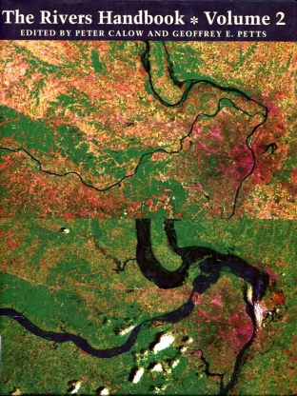
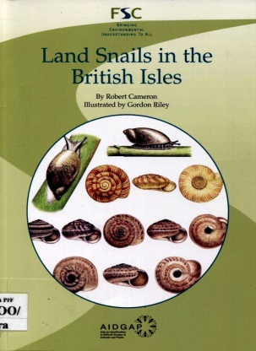
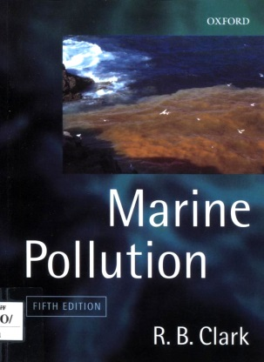
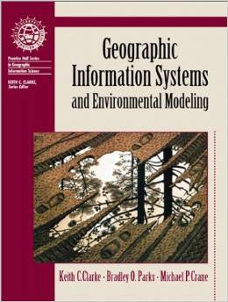
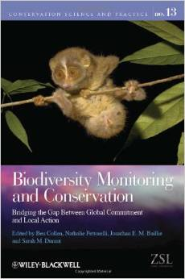
Calow P, Petts GE (eds.) (1994): The rivers handbook: Volume 2. Blackwell scientific publications, London, 523 pp.
Cameron R (2003): Land snails in the British Isles. FSC publications, Telford, 84 pp.
Clark RB (2001): Marine Pollution. Oxford University Press, New York, 237 pp.
Clarke KC (2001): Geographic information systems and environmental modeling. Prentice Hall, New Jersey, 306 pp.
Collen B, Pettorelli N, Baillie JEM, Durant SM (eds.) (2013): Biodiversity monitoring and conversation : bridging the gap between global commitment and local action. Wiley-Blackwell, Chichester, 464 pp.

Slide 11
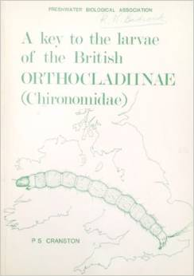
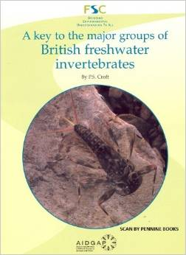
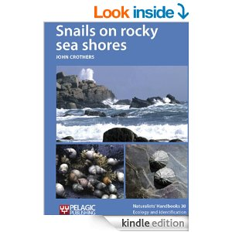
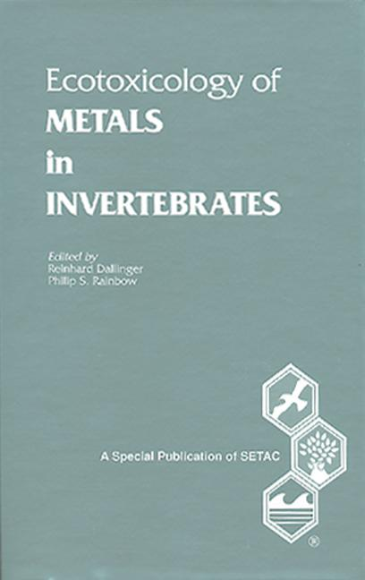
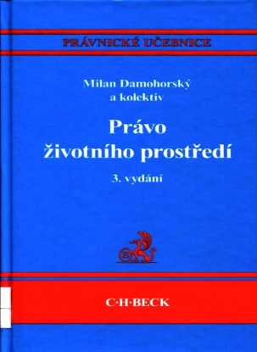
Cranston PS (1982): A key to the larvae of the British Orthocladiinae (Chironomidae). Freshwater Biological Association, Ambleside, 152 pp.
Croft PS (1986): A key to the major groups of British freshwater invertebrates. FSC Publications, Shrewsbury, 48 pp.
Crothers J (2012): Snails on rocky sea shores. Pelagic Publishing, Exeter, 179 pp.
Dallinger R, Rainbow PS (eds.) (1993): Ecotoxicology of Metals in Invertebrates. CRC Press, London, 480 pp.
Damohorský (ed.) (2010): Právo životního prostředí. C. H. Beck, Praha, 678 pp.

Slide 12





Das MM, Saikia MD (2009): Hydrology. PHI, New Delhi, 372 pp.
Davis H (2010): Kreativní detail a makro: Tipy a techniky pro digitální fotografie. Computer press, Brno, 240 pp.
Debelius H (2013): Indian Ocean reef guide: Maldives, Sri Lanka, Thailand, South Africa, Mauritius, Madagascar, East Africa, Seychelles. ConchBooks, Harxheim, 321 pp.
Debelius H, Kuiter R (2007): Nudibranchs of the world: 1,200 nudibranchs from around the world with more than 2,500 photographs. IKAN-Unterwasserarc hiv, Frankfurt, 360 pp.
Dijkstra KDB (2014): Libellen Europas : der Bestimmungsführer. Haupt, Bern, 320 pp.

Slide 13





Dillon RT (2000): The ecology of freshwater molluscs. Cambridge university press, Cambridge, 509 pp.
Disney RHL (1999): British Dixidae (meniskus midges) and Thaumaleidae (trickle midges: keys with ecological notes. Freshwater Biological Association, Ambleside, 128 pp.
Dobson M, Pawley S, Fletcher M, Powell A (2012): Guide to freshwater invertebrates. Freshwater Biological Association, Ambleside, 216 pp.
Dodds W, Whilles M (2010): Freshwater ecology: Concepts & environmental applications of limnology. Academic Press, Burlington, 811 pp.
Dorava JM, Montgomery DR, Palcsak BB, Fitzpatrick FA (eds.) (2001): Geomorphic processes and riverine habitat. American geophysical union, Washington, DC, 253 pp.

Slide 14





Dungel J, Řehák Z (2011): Atlas ryb, obojživelníků a plazů České a Slovenské republiky. Academia, Praha, 181 pp.
Dungel J, Hudec K (2013): Atlas ptáků České a Slovenské republiky. Academia, Praha, 252 pp.
Dürr S, Thomason JC (2010): Biofouling. Wiley – Blackwell, Chichester, 429 pp.
Dvořák P, Pyszko M, Velíšek J, Dvořáková Líšková Z, Andreji J (2014): Anatomie a fyziologie ryb. FROV JU, Vodňany, 189 pp.
Ebert DA, Fowler S (2014): An illustrated pocket guide to the sharks of the world. Wild nature press, Plymouth, 256 pp.

Slide 15





Elliott JM (2009): Freshwater megaloptera and neuroptera of Britain and Ireland: keys to adults and larvae, and a review of their ekology. Freshwater Biological Association, Ambleside, 71 pp.
Elliott JM, Humpesch UH (2010): Mayfly larvae (Ephemeroptera) of Britain and Ireland: keys and a review of their ecology. Freshwater Biological Association, Ambleside, 152 pp.
Elliott JM, Mann KH (1979): A key to the British freshwate leeches: with notes on their life cycles and ecology. Freshwater Biological Association, Ambleside, 72 pp.
Eloranta P, Kwandrans J, Kusel-Fetzmann E (2011): Rhodophyta and Phaeophyceae. Spektrum Akademischer Verlag, Heidelberg, 156 pp.
Erhardt H, Knop D, Debelius H (2005): Corals: Indo-Pacific field guide. IKAN-Unterwasserarc hiv, Frankfurt, 306 pp.

Slide 16





Ettl H, Gärtner G (2008): Chlorophyta 2. Teil / part 2: Tetrasporales, Chlorococcales, Gloeodendrales. Spektrum Akademischer Verlag, Heidelberg, 436 pp.
Farndon J, Safina C (2011): Atlas of Oceans: An Ecological Survey of Underwater Life. Yale University Press, New Haven, 256 pp.
Fatherree J (1998): Soft corals: [selecting and maintaining soft corals feeding and algal symbiosis lighting and water clarity]. T.F.H. Publications, Neptune City, N.J., 96 pp.
Fatherree J (1999): Hard corals: [selecting and maintaining hard corals feeding and algal symbiosis lighting and water clarity]. T.F.H. Publications, Neptune City, N.J., 96 pp.
Flannagan JF, Marshall KE (eds.) (1980): Advances in Ephemeroptera biology. Plenum press, New York, 552 pp.

Slide 17





Flegr J (2007): Úvod do evoluční biologie. Academia, Praha, 544 pp.
Flegr J (2011): Pozor, Toxo: tajná učebnice praktické metodologie vědy. Academia, Praha, 352 pp.
Flügel E (ed.) (2011): Fossil Algae: Recent Results and Developments. Springer, Berlin, 378 pp.
Fretter V, Graham A (1999): British Prosobranch Molluscs. Ray Society, London, 820 pp.
Frid Ch, Dobson M (2013): Ecology of aquatic management. Oxford University Press, Oxford, 339 pp.

Slide 18





Fryer G (1982): The parasitic copepoda and branchiura of British freshwater fishes: a handbook and key. Freshwater Biological Association, Ambleside, 87 pp.
Fryxell GA (ed.) (2011): Survival Strategies of the Algae. Cambridge University Press, Cambridge, 158 pp.
Gaisler J, Zima J (2007): Zoologie obratlovců, Academia, Praha, 692 pp.
Gaston KJ, Spicer JI (2004): Biodiversity: an introduction. Blackwell publishing, Malden, 191 pp.
Gergel SE, Turner MG (Eds.) (2002): Learning Landscape Ecology: A Practical Guide to Concepts and Techniques. Springer, New York, 316 pp.

Slide 19





Gibson R (1994): Nemerteans. Field studies council, Shrewsbury, 224 pp.
Gibson CH (2012): Mořské pobřeží: nový kapesní atlas. Slovart, Praha, 224 pp.
Goldman ChR, Kumagai M, Robarts RD (2013): Climatic change and global warming of inland waters: Impact and mitigation for ecosystems and societies. Wiley – Blackwell, Chichester, 472 pp.
Gordon ND, McMahon TA, Finlayson BL, Gippel ChJ, Nathan RJ (2004): Stream hydrology: An introduction for ecologists. John Wiley & Sons, Chichester, 429 pp.
Graf W, Murphy J, Dahl J, Zamora-Munoz C, López-Rodríguez MJ (2008): Distribution and ecological preferences of european freshwater organism: Volume 1 Trichoptera. Pensoft, Sofia, 388 pp.

Slide 20





Graf W, Lorenz AW, Tierno de Figueroa JM, Lücke S, López-Rodríguez MJ, Davies C (2009): Distribution and ecological preferences of european freshwater organism: Volume 2 Plecoptera. Pensoft, Sofia, 262 pp.
Grafton RQ, Hussey K (eds.) (2011): Water resources planning and management. Cambridge university press, Cambridge, 777 pp.
Gremlica T, Vrabec V, Cílek V, Zavail V, Leošová A, Volf O (2013): Industriální krajina a její přirozená obnova: právní východiska a rekultivační metodika oblastí narušených těžbou. Novela bohemica, Praha, 110 pp.
Harari YN (2013): Sapiens: od zvířete k božskému jedinci. Leda, Voznice, 518 pp.
Harker J (1989): Mayflies. Richmond Publishing Co. Ltd., Slough, 56 pp.

Slide 21





Hartman P (2006): Hydrobiologie. Informatorium, Praha, 359 pp.
Hartman P, Bendářová D, Mikl R (2012): Management akvakultury. Jihočeská univerzita v Českých Budějovicích, 202 pp.
Hartman P, Regenda J (2014): Praktika v rybníkářství. FROV JU, Vodňany, 374 pp.
Hatcher P, Battey N (2011): Biological diversity: exploiters and exploited. Wiley-Blackwell, Chichester, 436 pp.
Hayward PJ (1985): Ctenostome bryozoans: keys and notes for the identification of the species. E.J. Brill, London, 169 pp.

Slide 22





Hayward PJ (1985): Cyclostome bryozoans: keys and notes for the indentification of the species. E.J. Brill, London, 147 pp.
Hayward PJ (1994): Animals of sandy shores. Richmond Publishing, Slough, 104 pp.
Hayward PJ, Nelson-Smith T, Shields Ch (1996): Collins pocket guide: sea shore of Britain & Europe. HarperCollins Publishers, London, 352 pp.
Helfman GS, Collette BB, Facey DE, Bowen BW (2009): The diversity of fishes: biology, evolution and ecology. Wiley – Blackwell, Chichester, 720 pp.
Henrikson R, Edwards M (2013): Algae Microfarms: for home, school, community and urban gardens, rooftop, mobile and vertical farms and living buildings. CreateSpace Independent Publishing Platform, Seattle, 148 pp.

Slide 23





Herring P (2002): The biology of the deep ocean. Oxford Universty Press, New York, 314 pp.
Hogarth PJ (2007): The biology of mangroves and seagrasses. Oxford University Press, New York, 273 pp.
Horáková M (ed.) (2007): Analytika vody. VŠCHT Praha, 335 pp
Horálek V, Ševčík JGK, Čurdová E, Helán V (eds.) (2010): Vzorkování I: obecné zásady. 2 Theta, Český Těšín, 131 pp.
Horsák M, Juřičková L, Picka J (2013): Měkkýši České a Slovenské republiky. Kabourek, Zlín, 264 pp.

Slide 24





Housecroft C, Sharpe AG (2014): Anorganická chemie. VŠCHT, Praha, 1152 pp.
Hudec I (2010): Fauna Slovenska III. Veda, Bratislava, 496 pp.
Hurford C, Schneider M, Cowx I (eds.) (2010): Conservation monitoring in freshwater habitats: pracrical guide and case studies. Springer, Dordrecht, 415 pp.
Hůrka K (1996): Carabidae of the Czech and Slovak Republics. Kabourek, Zlín, 565 pp.
Hůrka K (2005): Brouci České a Slovenské republiky. Kabourek, Zlín, 390 pp.

Slide 25





Chaloupka V (2014): Zákon o vodovodech a kanalizacích: s prováděcí vyhláškou a podrobným komentářem po velké novele včetně dopadů nového občanského zákoníku k 1.4.2014. Sondy, Praha, 287 pp.
Cham S (2012): Field guide to the larvae and exuviae of British Dragonflies: Dragonflies (Anisoptera) and Damseflies (Zygoptera). British Dragonfly Society, Whittlesey, 152 pp.
Chase R (2002): Behavior and its neural control in gastropod molluscs. Oxford University Press, New York, 314 pp.
Chinery M (2009): Collins complete guide to British insects. Collins, London, 384 pp.
Jamieson A (2015): The hadal zone: life in the deepest oceans. Cambridge University Press, Cambridge, 382 pp.

Slide 26





Johnson WS, Allen DM (2012): Zooplankton of the atlantic and gulf coasts: A guide to their identification and ecology. The Johns Hopkins University press, Baltimore, 452 pp.
Jursík F (2001): Anorganická chemie nekovů. VŠCHT, Praha, 228 pp.
Jursík F (2002): Anorganická chemie kovů. VŠCHT, Praha, 152 pp.
Kadlubowska JZ (2009): Chlorophyta 8. Teil / part 8: Conjugatophyceae I: Zygnemales. Spektrum Akademischer Verlag, Heidelberg, 532 pp.
Kaiser MJ, Attrill MJ, Jennings S, Thomas DN, Barnes DKA, Brierley AS, Hiddink JG, Kaartokallio H, Polunin NVC, Raffaelli DG (2011): Marine ecology: processes, systems and impacts. Oxford University Press, New York, 501 pp.

Slide 27





Kamps HJ (2008): Makrofotografie. Zoner press, Brno, 255 pp.
Kernan M, Battarbee RW, Moss B (eds.) (2010): Climate change impacts on freshwater ecosystems. Wiley – Blackwell, Chichester, 314 pp.
Kerney MP (1999): Atlas of Land and Freshwater Molluscs of Britain and Ireland. Harley Books, Colchester, 272 pp.
Khanna DR, Yadav PR (2008): Biology of Coelenterata. Discovery Publishing House, New Delfi, 393 pp.
Kileen I, Aldridge D, Oliver G (2004): Freshwater bivalves of Britain and Ireland. Field studies council, Shrewsbury, 114 pp.

Slide 28





Kirkpatrick PA, Pugh PR (1984): Siphonophores and velellids: keys and notes for the identification of the species. E.J. Brill, London, 154 pp..
Kis B (1974): Fauna republicii socialiste, Romania insecta. Academia republicii socialiste Romania, Bukurešť, 271 pp.
Kočárek P (2013): Rovnokřídlí (Insecta: Orthoptera) České republiky. Academia, Praha, 283 pp.
Kočárek P, Holuša J, Vidlička L (2005): Blattaria, Mantodea, Orthoptera a Dermaptera České a Slovenské republiky. Kabourek, Zlín, 348 pp.
Kočíková P (1998): Evropská unie a životní prostředí: politiky, strategie, legislativa. Montanex, Ostrava, 182 pp.

Slide 29





Koese B (2008): De Nederlandse steenvliegen (Plecoptera). Nederlandse Entomologische Vereniging, 158 pp.
Köhler G (2012): Color Catalogue for Field Biologists. Herpeton, Offenbach am Main, 49 pp.
Kolář F, Matějů J, Lučanová M, Chlumská Z, Černá K, Prach J, Baláž V, Falteisek L (2012): Ochrana přírody z pohledu biologa: proč a jak chránit českou přírodu. Dokořán, Praha, 213 pp.
Krasny ME (2003): Invasion ecology : teacher's guide. NSTA Press, Arlington, 230 pp.
Kremer BP (2013): Mikroskop zcela jednoduše: preparace, barvení i digitální mikrofotografie krok za krokem. Aventinum, Praha, 189 pp.

Slide 30





Kriska G (2013): Freshwater Invertebrates in Central Europe: A Field Guide. Springer Berlin, 412 pp.
.
Kristiansen J, Preisig HR (2007): Chrysophyte and Haptophyte algae 2. Teil / part 2: Synurophyceae. Spektrum Akademischer Verlag, Heidelberg, 252 pp.
Kůrka A (2015): Pavouci České republiky. Academia, Praha, 624 pp.
Kutílek M (2008): Racionálně o globálním oteplování. Dokořán, Praha, 185 pp.
Lampert W, Sommer U (2007): Limnoecology: The ecology of lakes and streams. Oxford University Press, New York, 324 pp.

Slide 31





Lancaster J, Downes BJ (2013): Aquatic entomology. Oxford University Press, Oxford, 304 pp..
Lange-Bertalot H (ed.) (2013): Diatomeen im Süßwasser - Benthos von Mitteleuropa. Koeltz scientific books, Koenigstein, 908 pp.
Langton PH, Pinder LCV (2007): Keys to the adult male chironomidae of Britain and Ireland. Freshwater Biological Association, Ambleside, 407 pp.
Larink O, Westheide W (2011): Coastal plankton: photo guide for European seas. Verlag Friedrich Pfeil, München, 143 pp.
Larson EJ (2009): Evoluce: pozoruhodný příběh dějin vědecké teorie. Slovart, Praha, 326 pp.

Slide 32





Leschen RAB (2013): Arthropoda: Insecta: Coleoptera. de Gruyter, Berlin, 550 pp.
Leschen RAB, Beutel RG (2014): Handbook of Zoology: Coleoptera, Beetles. De Gruyter, Berlin, 675 pp.
Lillehammer A (1988): Stoneflies (Plecoptera) of Fennoscandia and Denmark. E.J. Brill, Leiden, 165 pp.
Lillywhite HB (2014): How Snakes Work: Structure, Function and Behavior of the World's Snakes. Oxford University Press, Oxford, 256 pp.
Linhart I (2012): Toxikologie: Interakce škodlivých látek s živými organismy, jejich mechanismy, projevy a důsledky. VŠCHT Praha, 376 pp.

Slide 33





Linhart I (2014): Toxikologie: Interakce škodlivých látek s živými organismy, jejich mechanismy, projevy a důsledky. VŠCHT, Praha, 412 pp.
.
Little C (2000): The biology of soft shores and estuaries. Oxford University Press, New York, 252 pp.
Little C, Williams GA, Trowbridge CD (2009): The biology of rocky shores. Oxford University Press, New York, 356 pp.
Lomborg B (2008): Zchlaďte hlavy: skeptický ekolog o globálním oteplování. Dokořán, Praha, 360 pp.
Lorenz K (2014): Osm smrtelných hříchů civilizace. Leda, Voznice, 137 pp.

Slide 34





Ložek V (2011): Po stopách pravěkých dějů: o silách, které vytvářely naši krajinu. Dokořán, Praha, 184 pp..
Lydeard Ch, Lindberg D, Vermeij G (2003): Molecular systematics and phylogeography of mollusks. Smithsonian Books, Washington, D.C., 328 pp.
Lyon JG (ed.) (2002): GIS for water resources and watershed management. Taylor & Francis, London, 274 pp.
Macadam C, Bennett C (2010): A pictorial guide to British Ephemeroptera. FSC Publications, Telford, 132 pp.
Macan TT (1982): The study of stoneflies, mayflies and caddis flies. Amateur Entomologists' Society, 44 pp.

Slide 35





Macek J (2012): Blanokřídlí České republiky. Academia, Praha, 524 pp..
Macek J, Dvořák J, Traxler R, Červenka V (2007): Motýli a housenky střední Evropy: Noční motýli I. Academia, Praha, 340 pp.
Macek J, Dvořák J, Traxler R, Červenka V (2009): Motýli a housenky střední Evropy: Noční motýli II. Academia, Praha, 490 pp.
Malicky H (2004): Atlas of European Trichoptera: Atlas der Europäischen Köcherfliegen = Atlas des Trichopteres d'Europe. Springer, Dordrecht, 359 pp.
Maštera J, Zavadil V, Dvořák J (2015): Vajíčka a larvy obojživelníků České republiky. Academia, Praha, 180 pp.

Slide 36





Matějček T (2007): Malý geografický a ekologický slovník: příručka pro školy i veřejnost. Nakladatelství České geografické společnosti, Praha, 132 pp..
Mays LW (ed.) (2010): Ancient Water Technologies. Springer, Berlin, 239 pp.
McMurry J (2007): Organická chemie. VŠCHT, Praha, 1270 pp.
Mikátová B, Vlašín M, Zavadil V (eds.) (2001): Atlas rozšíření plazů v České republice. Atlas of the distribution of reptiles in the Czech Republic. AOPK ČR, Praha, 256 pp.
Miller ChB, Wheeler PA (2012): Biological oceanography. Wiley – Blackwell, Chichester, 464 pp.

Slide 37





Moller Pillot HKM (2009): Chironomidae larvae of the Netherlands and adjacent lowlands: biology and ecology of the Chironomini. KNNV Publishing, Zeist, 270 pp..
Moller Pillot HKM (2013): Chironomidae larvae of the Netherlands and adjacent lowlands: biology and ecology of the aquatic Orthocladiinae. KNNV Publishing, Zeist, 312 pp.
Moore R (2014): In Search of Lost Frogs: The Quest to Find the World's Rarest Amphibians. Firefly Books, Richmond Hill, 256 pp.
Musy A, Higy Ch (2011): Hydrology: A science of nature. Science publishers, Enfield, 326 pp.
Nentwig W (ed.) (2014): Nevítaní vetřelci: invazní rostliny a živočichové v Evropě. Academia, Praha, 247 pp.

Slide 38





Newell GE, Newell RC (2006): Marine plankton: A practical guide. Pisces conservation Ltd., Pennigton, 228 pp.
.
Newman L, Cannon L (2005): Fabulous flatworms: a guide to marine polyclads. CSIRO Publishing, Collingwood.
Nielsen C (1989): Entoprocts: keys and notes for the identification of the species. E.J. Brill, Leiden, 131 pp.
Page LM, Burr BM (2011): Peterson field guide to freshwater fishes of North America north of Mexico. Houghton Mifflin Harcourt, Boston, 688 pp.
Pease A, Pease B (2013): Řeč těla lásky. Portál, Praha, 110 pp.

Slide 39





Pekár S (2009): Moderní analýza biologických dat. Masarykova univerzita, Brno, 236 pp..
Penney D, Jepson JE (2014): Fossil insects: an introduction to palaeoentomology. Siri Scientific Press, Manchester, 224 pp.
Pennigton KL, Cech TV (2010): Introduction to water resources and environmental issues. Cambridge university press, Cambridge, 457 pp.
Peregrine productions (2001): Mayfly Nymphs. Peregrine Productions, Little Blakenham, 2 pp.
Peregrine productions (2003): Semi-aquatic pyralid moths. Peregrine Productions, Little Blakenham, 2 pp.

Slide 40





Petts G, Calow P (eds.) (1996): River biota: diversity and dynamics. Blackwell science, Oxford, 257 pp.
Pihan R (2013): Mistroství práce s DSLR (8. vydání). IDIF Publishing, Vlkov, 284 pp.
Pipkin BW, Gorsline DS, Casey RE, Dunn DA, Schellenberg SA (2001): Laboratory exercises in oceanography. W.H. Freeman and company, New York, 270 pp.
Pitter P (2009): Hydrochemie, 4. aktualizované vydání. VŠCHT Praha, 592 pp.
Plant CW (2013): A key to the adults of British lacewings and their allies. Field studies council, Telford, 90 pp.

Slide 41





Pontin RM (1978): A key to the freshwater planktonic and semi-planktonic Rotifera of the British Isles. Freshwater Biological Association, Ambleside, 178 pp.
Porter J (2012): Seasearch guide to bryozoans and hydroids of Britain and Ireland. Marine Conservation Society, Herefordshire
Prach K, Štech M, Říha P (2009): Ekologie a rozšíření biomů na Zemi. Scientia, Praha, 151 pp.
Primack RB, Kindlmann P, Jersáková J (2011): Úvod do biologie ochrany přírody. Portál, Praha, 472 pp.
Pryce D, Macadam C, Brooks S (2007): Guide to the British stonefly (Plecoptera) families: adults and larvae. Field studies council, Shrewsbury

Slide 42





Pytl V (2012): Podzemní vody České republiky. Milpo media, Praha, 175 pp.
Rahman AA, Boguslawski P, Gold Ch, Said MN (eds.) (2013): Developments in multidimensional spatial data models. Springer, Berlin, 249 pp.
Randák T (2013): Rybářství ve volných vodách. FROV JU, Vodňany, 434 pp.
Reay D, Smith P, van Amstel A. (eds.) (2010): Methane and climate change. Earthscan, London, 272 pp.
Reischig J (2002): Výukové videopořady. Mantis, Plzeň

Slide 43





Reischig J, Buchar J (2001): Videoatlas bezobratlých živočichů. Mantis, Plzeň
Rex MA, Etter RJ (2010): Deep-sea biodiversity: pattern and scale. Harvard University Press, Cambridge, 368 pp.
Reynaud EG (ed.) (2014): Imaging marine life: Macrophotography and microscopy approaches for marine biology. Wiley – Blackwell, Weinheim, 253 pp.
Reynoldson TB, Young JO (2000): A key to the freshwater triclads of Britain and Ireland with notes on their ecology. Freshwater biological association, Ambleside, 72 pp.
Ridley M (2007): Červená královna: [sexualita a vývoj lidské přirozenosti]. Portál, Praha, 315 pp.

Slide 44





Richmond A, Hu Q (2013): Handbook of Microalgal Culture: Applied Phycology and Biotechnology. Wiley-Blackwell, Chichester, 736 pp.
Robin A (2011): Encyclopedia of marine bivalves: Scaphopoda, Polyplacophora, Cephalopoda. AFC Xenophora, Paris, 302 pp.
Roni P, Beechie T (eds.) (2013): Stream and watershed restoration: A guide to restoring riverine processes and habitats. Wiley – Blackwell, Chichester, 300 pp.
Rosypal S (2003): Nový přehled biologie. Scientia, Praha, 797 pp.
Samuels ML, Witmer JA, Schaffner A (2012): Statistics for the life sciences. Pearson, Boston, 654 pp.

Slide 45





Sandgren CD, Smol JP, Kristiansen J (eds.) (2009): Chrysophyte Algae: Ecology, Phylogeny and Development. Cambridge University Press, Cambridge, 416 pp.
Sands P, Peel J, Fabra A, MacKenzie R (2012): Principles of International Environmental Law. Cambridge University Press, Cambridge, 992 pp.
Sartori M, Landolt P (1999): Atlas de distribution des ephemeres de suisse (Insecta, Ephemeroptera). Schweizerische Entomologische Gesellschaft, Zürich, 214 pp.
Sauter W (ed.) (1997): Fauna Insecta Helvetica. Schweizerische Entomologische Gesellschaft, Zürich, 298 pp.
Savage AA (1999): Keys to the larvae of British Corixidae. Freshwater Biological Association, Ambleside, 56 pp.

Slide 46





Savage JM (2002): The amphibians and reptiles of Costa Rica: A herpetofauna between two continents, between two seas. The University of Chicago press, Chicago, 934 pp.
Scourfield DJ, Harding JP (1958): A key to the British freshwater cladocera: with notes on their ecology. Freshwater Biological Association, Ambleside, 55 pp.
Schneller P, Pantchev E (2008): Parasitology in Snakes, Lizards and Chelonians: A Husbandry Guide. Edition Chimaira, Frankfurt am Main, 203 pp.
Schultz GA, Engman ET (eds.) (2000): Remote Sensing in Hydrology and Water Management. Springer, Berlin, 483 pp.
Simmonds MP, Molleson L (2012): Guide to the UK cetaceans and seals. FSC Publications, Telford

Slide 47





Singh M, Singh RB, Hassan MI (Eds.) (2014): Landscape Ecology and Water Management: Proceedings of IGU Rohtak Conference, Vol. 2. Springer, New York, 352 pp.
Smallshire D, Swash A (2010): Britain's dragonflies: a field guide to the damselflies and dragonflies of Britain and Ireland. Princeton University Press, Princeton, 208 pp.
Smrž J (2013): Základy biologie, ekologie a systému bezobratlých živočichů. Karolinum, Praha, 192 pp.
Sparreboom M (2014): Salamanders of the Old World: The Salamanders of Europe, Asia and Northern Africa. KNNV publishing, Zeist, 432 pp.
Spector P (2008): Data Manipulation with R. Springer, New York, 154 pp.

Slide 48





Speight M, Henderson P (2010): Marine ecology: Concepts and applications. Wiley – Blackwell, Chichester, 276 pp.
Sterner RW, Elser JJ (2002): Ecological stoichiometry: The biology of elements from molecules to the biosphere. Princeton university press, Princeton, 439 pp.
Swain A (2013): Managing Water Conflict: Asia, Africa and the Middle East. Routledge, Abingdon, 256 pp.
Tebbani S, Filali R, Lopes F, Dumur D, Pareau D (2014): CO₂ Biofixation by Microalgae: Automation Process. Wiley-ISTE, Chichester, 192 pp.
Thompson TE (1989): Molluscs: benthic opisthobranchs: keys and notes for the identification of the species = (Mollusca: Gastropoda). E.J. Brill, Leiden, 356 pp.

Slide 49





Tkadlec E (2008): Populační ekologie: struktura, růst a dynamika populací. Univerzita Palackého v Olomouci, 400 pp.
Tomancová J (ed.) (2010): Základy práva (nejen) pro školy. Albert, Boskovice, 305 pp.
Townsend DW (2012): Oceanography and marine biology: An introduction to marine science. Sinauer associates, Sunderland, 512 pp
Valentová O, Máchová J, Kroupová H (2013): Základy hydrochemie - návody pro laboratorní cvičení. Jihočeská univerzita v Českých Budějovicích, 123 pp.
Vallenduuk HJ, Pillot HKM (2007): Chironomidae larvae of the Netherlands and adjacent lowlands : general ekology and tanypodinae. KNNV Publ., Zeist, 144 pp.

Slide 50





van Andel J, Aronson J (eds.) (2012): Restoration ecology: The new frontier. Wiley – Blackwell, Chichester, 381 pp.
Velíšek J, Svobodová Z, Blahová J, Máchová J, Stará A, Dobšíková R, Široká Z, Modrá H, Valentová O, Randák T, Štěpánová S, Kocour Kroupová H, Maršálek P, Grabic R, Zusková E, Bartošková E, Stancová V (2014): Vodní toxikologie pro rybáře. FROV JU, Vodňany, 600 pp.
Veron JEN (1993): Corals of Australia and the Indo-Pacific. University of Hawai'i Press, Honolulu, 644 pp.
Visser H, van Zanten (2000): European limnofauna: a pictorial key to the families. Springer, New York
Volf P, Horák P (2007): Paraziti a jejich biologie. Triton, Praha, 318 pp.

Slide 51





Vymětal J (2012): Informační zdroje v životním prostředí. Wolters Kluwer ČR, Praha, 180 pp.
Wagner R, Marxsen J, Zwick P, Cox EJ (eds.) (2011): Central european stream ecosystems: The long term study of the Breitenbach. Wiley – Blackwell, Weinheim, 672 pp.
Wainwright J, Mulligan M (eds.) (2013): Environmental modelling: Finding simplicity in complexity (second edition). Wiley-Blackwell, Oxford, 475 pp.
Waldbauer G (2008): A walk around the pond: insects in and over the water. Harvard University Press, Cambridge, 312 pp.
Walker D, Cresswell G (2011): Whales and dolphins of the European Atlantic : the Bay of Biscay, English Channel, Celtic Sea and coastal SW Ireland. Wild Guides, Old
Basing, 88 pp.

Slide 52





Wallace I (2006): Simple key to caddis larvae. Field studies council, Telford, 59 pp.
Wallace ID, Wallace B (1990): Keys to the case-bearing caddis larvae of Britain and Ireland. Freshwater Biological Association, 240 pp.
Wang LK, Chen JP, Hung YT, Shammas NK (eds.) (2009): Heavy Metals in the Environment. CRC Press, London, 516 pp.
Ward AD, Trimble SW (2003): Environmental Hydrology. CRC Press, London, 502 pp.
Wareham DC (2005): Elsevier's Dictionary of Herpetological and Related Terms. Elsevier, Amsterdam, 240 pp.

Slide 53





Waringer J, Graf W (2011): Atlas of central european trichoptera larvae. Erik Mauch Verlag, Dinkelscherben, 468 pp.
Welter-Schultes F (2012): European non-marine molluscs, a guide for species identification: Bestimmungsbuch für europäische Land- und Süsswassermollusken. Planet Poster Editions, Göttingen, 760 pp.
Wiggins GB (2004): Caddisflies: The underwater architects. University of Toronto Press, Toronto, 292 pp.
Wilson S, Swan G (2013): A complete guide to reptiles of Australia. New Holland Publishers, London, 592 pp.
Wood CH (2013): Sea anemones and corals of Britain and Ireland. Wild nature press, Plymouth, 160 pp.

Slide 54





Wood Ch (2013): The diver's guide to marine life of of Britain and Ireland. Wild nature press, Plymouth, 160 pp.
Wood TS, Okamura B (2005): A new key to the freshwater bryozoans of Britain, Ireland and continental Europe: with notes on their ecology. Freshwater Biological Association, Ambleside, 113 pp.
Yang Z (2014): Molecular Evolution: A Statistical Approach. Oxford University Press, Oxford, 512 pp.
Zelený V (2013): Rostliny Středozemí. Academia, Praha, 508 pp.
Zuur AF, Ieno EN, Meesters EHWG (2009): A Beginner´s guide to R. Springer, Dordrecht, 218 pp.

Slide 55





ČSN 75 7220 Jakost vod - Kontrola jakosti povrchových vod
.
ČSN EN ISO 5667-3 Jakost vod - Odběr vzorků - Část 3: Pokyny pro konzervaci vzorků a manipulaci s nimi
ČSN ISO 5667-4 Jakost vod - Odběr vzorků - Část 4: Pokyny pro odběr vzorků z vodních nádrží
ČSN ISO 5667-5 Jakost vod - Odběr vzorků - Část 5: Návod pro odběr vzorků pitné vody z úpraven vody a z vodovodních sítí
ČSN ISO 5667-6 Jakost vod - Odběr vzorků - Část 6: Návod pro odběr vzorků z řek a potoků

Slide 56





ČSN ISO 5667-10 Jakost vod - Odběr vzorků - Část 10: Pokyny pro odběr vzorků odpadních vod
.
ČSN ISO 5667-11 Jakost vod - Odběr vzorků - Část 11: Pokyny pro odběr vzorků podzemních vod
ČSN ISO 5667-12 Jakost vod - Odběr vzorků - Část 12: Pokyny pro odběr vzorků dnových sedimentů
ČSN ISO 5667-14 Jakost vod - Odběr vzorků - Část 14: Pokyny k zabezpečování jakosti odběru vzorků vod a manipulace s nimi
ČSN EN ISO 5667-16 Jakost vod - Odběr vzorků - Část 16: Pokyny pro biologické zkoušení vzorků

Slide 57

ČSN ISO 5667-17 Jakost vod - Odběr vzorků - Část 17: Návod pro odběr vzorků nerozpuštěných látek z velkých objemů vzorku
.

